Slide 1
Capstone Project on
AIRBNB BOOKING ANALYSIS by Raushan kumar, Rajiv Singh & Raja Naveen Kodati

Slide 2
CONTENT
Introduction
Problem Statements
Data Summary
Cleaning Data
Exploratory Data Analysis
Neighbourhood group Analysis
Top 10 host with maximum listing
Top 20 Neighbourhood
Top 10 Neighbourhood
Find the Top Single host listing across the neighbourhood group
Explore Neighbourhood in Manhattan area
Types of property listed across new York
Types of room according to neighbourhood group
Trend The Availability of room for 365 days
Price range distribution for rooms across new york
Neighbourhood with room avg price across new york

Slide 3
CONTENT
Top highest & lowest price of rooms in new york
Area wise reviews of the listed rooms
Price vs number of review of rooms across new york
Relation between hosts and most user reviews
Find busiest host & behind the reason
Noticeable Traffic difference across neighbourhood groups
Explore the relations according to geometrical location
Conclusion

Slide 4
Introduction
What is Airbnb ?
Airbnb, Inc. is an American vacation rental online marketplace company based in San Francisco, California, United States. Airbnb offers arrangement for lodging, primarily homestays, or tourism experiences.
The company does not own any of the real estate listings, nor does it host events. It acts as a broker, receiving commissions from each booking.
The company was founded in 2008 by Brian Cesky, Nathan Blecharczyk and Joe Gebbia.
Bookings platform of Airbnb is accessible via website and mobile app.

Slide 5
Problem Statement
Since 2008, guests and hosts have used Airbnb to expand on traveling possibilities and present a more unique, personalized way of experiencing the world. Today, Airbnb became one of a kind service that is used and recognized by the whole world. Data analysis on millions of listings provided through Airbnb is a crucial factor for the company. These millions of listings generate a lot of data - data that can be analyzed and used for security, business decisions, understanding of customers' and providers' (hosts) behavior and performance on the platform, guiding marketing initiatives, implementation of innovative additional services and much more.
Explore and analyze the data to discover key understandings (not limited to these) such as :
What can we learn about different hosts and areas?
What can we learn from predictions? (ex: locations, prices, reviews, etc)
Which hosts are the busiest and why?
Is there any noticeable difference of traffic among different areas and what could be the reason for it?

Slide 6
Data Summary
This dataset has around 49,000 observations in it with 16 columns and it is a mix between categorical and numeric values.
id: It is an Unique identification numbers of rooms.
name: provides the name of room.
host_id : unique number of hosts.
host_name : provide the host name.
Neighbouhood group : provides the name of boroughs of new York.
neighbourhood : provides the name of neighbourhoods.
latitude : provides the latitude of rooms.
longitude : provides the latitude of rooms.
room_type : provides types of room provide by host.

Slide 7
Data Summary
price : It provide the price of room.
minimum_nights : provides the number of minimum night availability of room.
number_of_reviews : provides the number of reviews of the specific room.
last_review : provides the last updated reviewed date via customer.
reviews_per_month : provides per month review for a room.
calculated_host_listings_count : provides the number of listing via same host.
availability_365 : room available for booking in day wise.

Slide 8
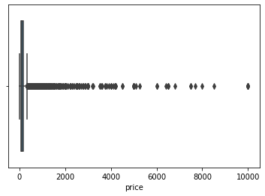
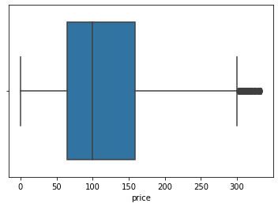
Cleaning Data
In the dataset, we have observed that there is the presence of some missing values in different features(columns), and thus, to make our datasets more lucrative, we must remove any outliers and null values that appear in different rows or columns.
We observed that the price column has so many outliers, so we have removed those and also we have removed null values from all columns.
Outliers presence in price columns
After removing outlier in price columns

Slide 9
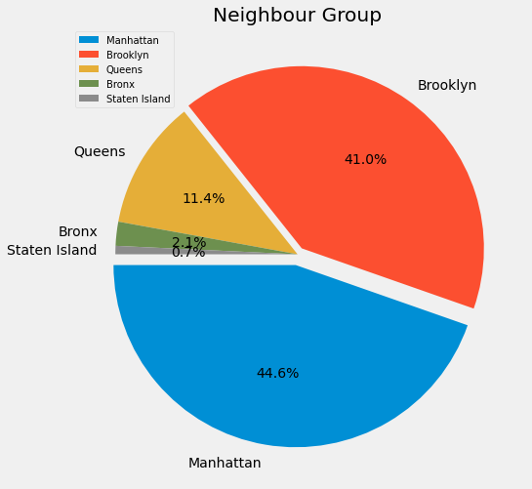
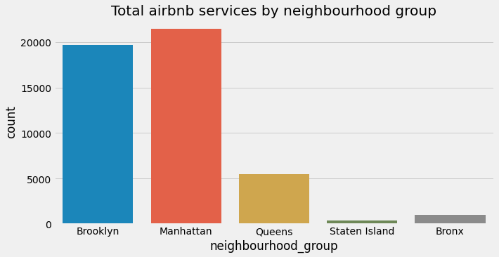
Exploratory Data Analysis
NEIGHBOURHOOD GROUP ANALYSIS
The majority of hosts of from Manhattan, Brooklyn afterward Queens, Bronx, and Staten Island.
2. Manhattan has 21422 hosts, Brooklyn has 19699 hosts, Queens has 5496 hosts, the Bronx has 1021hosts and Staten Island has 355 hosts.

Slide 10
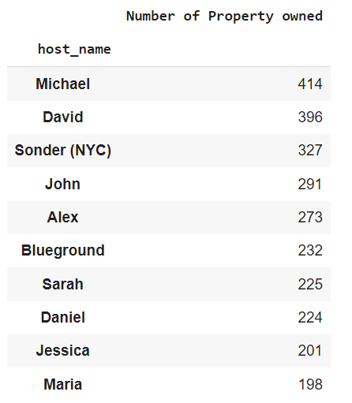
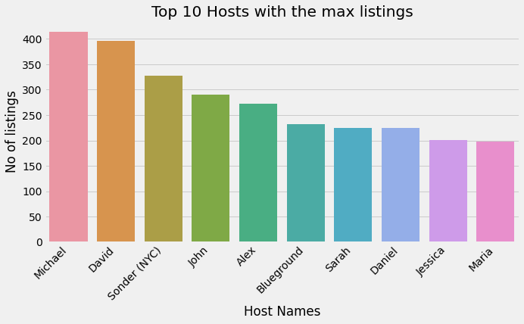
Exploratory Data Analysis
TOP 10 HOSTS
1. Top 10 hosts' names with maximum listing across New York.
2. Michael has the Top highest number of rooms listed.
3. David has the 2nd highest number of rooms is listed.

Slide 11
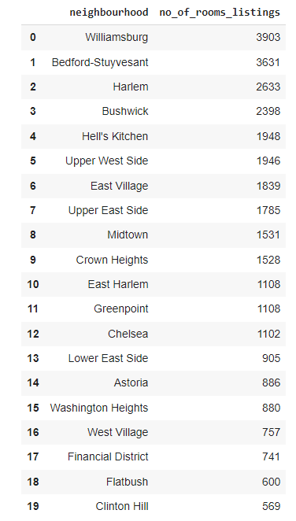
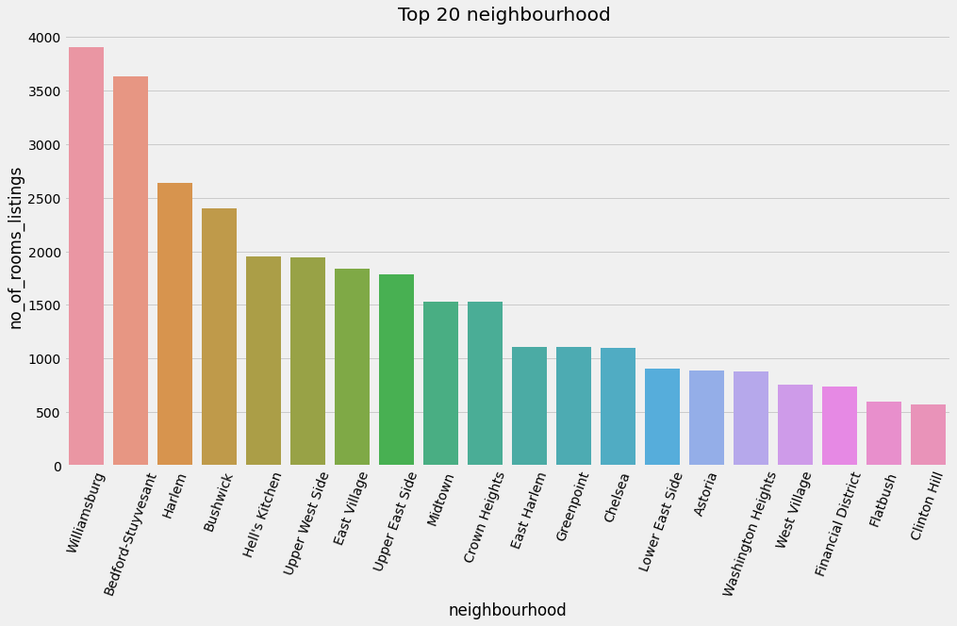
Exploratory Data Analysis
TOP 20 NEIGHBOURHOOD

Slide 12
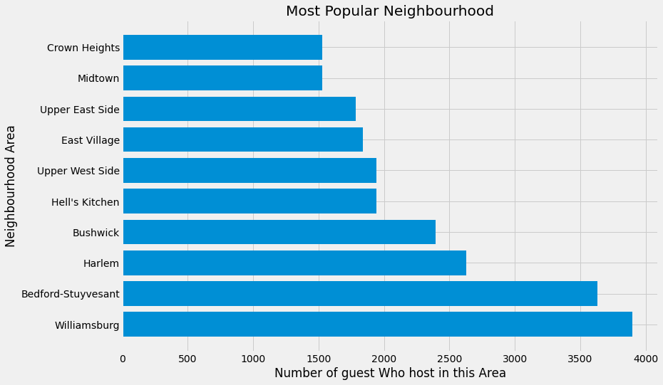
Exploratory Data Analysis
TOP 10 NEIGHBOURHOOD
Observation:
1. As we have observed maximum listing in the Williamsburg area.
2. Nos of listing in Williamsburg 3903.

Slide 13
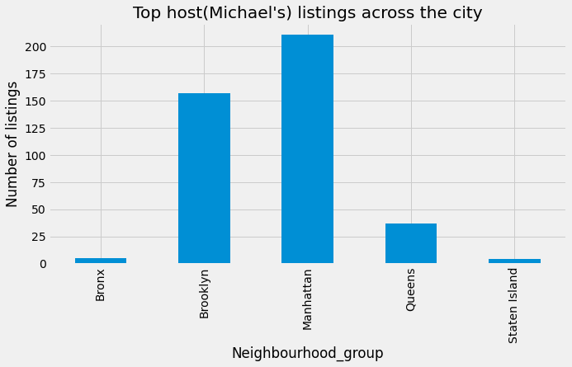
Exploratory Data Analysis
TOP SINGLE HOST (Michael) ACROSS NEIGHBOURHOOD GROUP
Observation:
1. As we have seen Michael has a maximum number of listings which is 414.
2. He has a maximum listing in Manhattan and Brooklyn.
3. He has listed their rooms across all neighborhood groups.

Slide 14
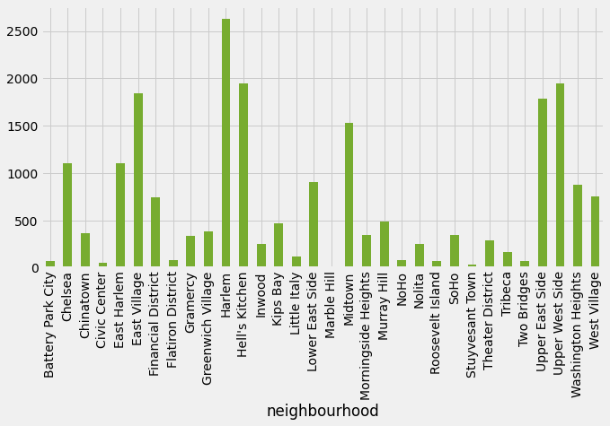
Exploratory Data Analysis
Explore neighbourhoods in Manhattan
Observation:
1. As we have observed, In Harlem maximum number of listings are found in the Manhattan borough.

Slide 15
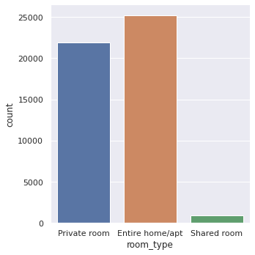
Exploratory Data Analysis
TYPES OF ROOM LISTING ACROSS NEW YORK
Entire home/apt 25204
Private room 21883
Shared room 906
Observation:
1. There are three types of options available for guests to stay-Entire home or apartment, a Private room, and a Shared room.
2. most of the listing is in the Entire home/apartment_room and then the Private room.
The least types of rooms are Shared types.

Slide 16
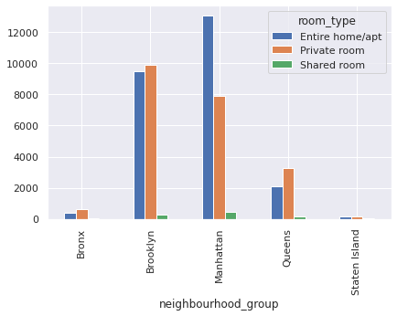
Exploratory Data Analysis
TYPES OF ROOM ACCORDING NEIGHBOURHOOD GROUP
Observation:
1. In Manhattan, mostly Entire home/apartment types room is listed.
2. In Brooklyn & Queens, maximum Private types of rooms are listed.
3. In the Bronx and Staten Island are almost equally listed of both private and entire home.

Slide 17
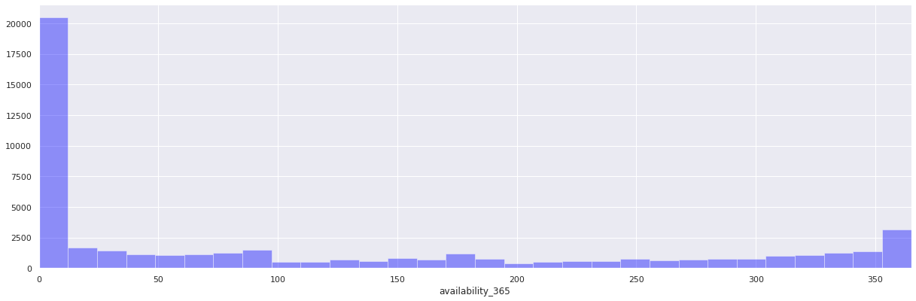
Exploratory Data Analysis
Trend The Availability of room for 365 days
Observation:
1. We found through this trend mostly room is available for booking within 5 days.
2. There is very less room available for booking for the whole year or (within 10 days to 365 days range).

Slide 18
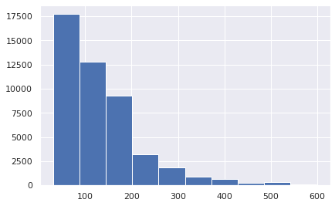
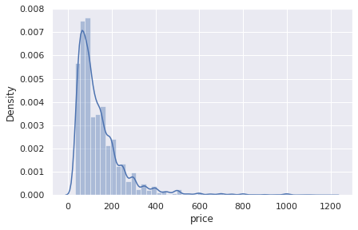
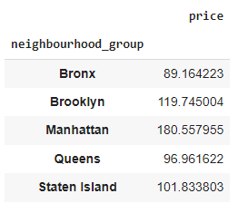
Exploratory Data Analysis
PRICE RANGE DISTRIBUTION FOR ROOMS ACROSS NYK
room Counts
price
Observation:
1. Price range is kept between 30 to 200 dollars for the most number of the listed room.
2. As avg price of the most room should be around between 100-150 dollars.
3. In Manhattan average price of a room is the highest.
4. In the Bronx the average price of a room is the lowest.

Slide 19
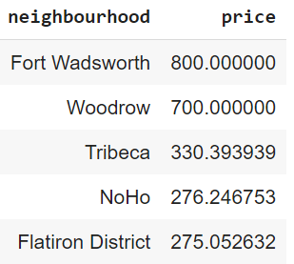
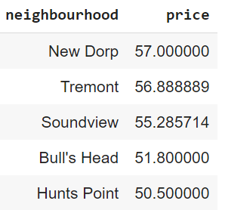
Exploratory Data Analysis
NEIGHBOURHOOD WITH ROOM AVG PRICE ACROSS NEWYORK
TOP 5 MOST EXPENSIVE NEIGHBOURHOOD
TOP 5 CHEAPEST NEIGHBOURHOOD

Slide 20
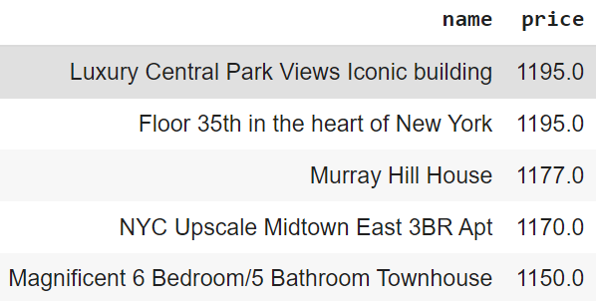
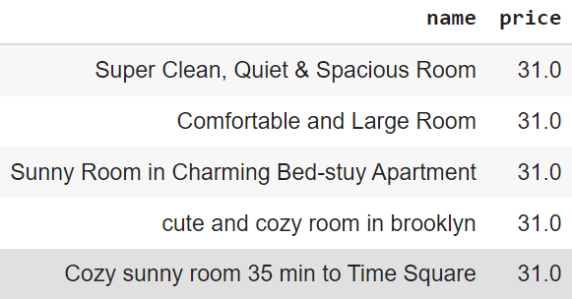
Exploratory Data Analysis
TOP HIGHEST & LOWEST PRICE OF ROOMS IN NYC
TOP 5 HIGHEST PRICE OF ROOM NAME
TOP 5 CHEAPEST PRICE OF ROOM NAME
Observation:
1. The price range of the Top 5 highest room between 1150-1195 dollars.
The top 5 cheapest room price is only 31 dollar.

Slide 21
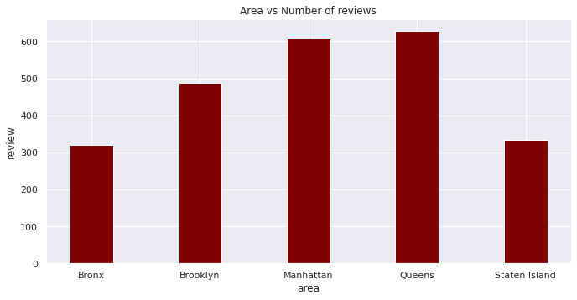
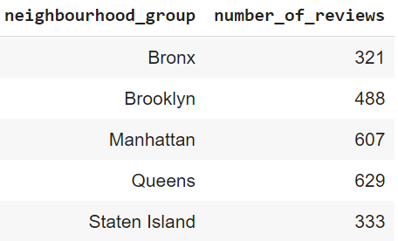
Exploratory Data Analysis
AREA WISE REVIEWS OF THE LISTED ROOMS
Observation:
1. Highest number of the review got in Queens and Manhattan areas.
2. Lowest number of reviews got in Staten Island and the Bronx.

Slide 22
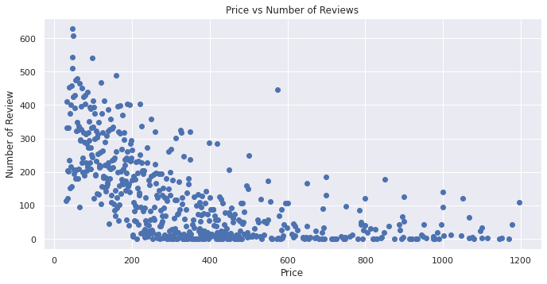
Exploratory Data Analysis
PRICE VS NUMBER OF REVIEW OF ROOMS ACROSS NYK
Observation:
Based on obtained scatterplot graph of "Price vs Number of Reviews" we can say that most people prefer to stay in a place where the price is less.

Slide 23
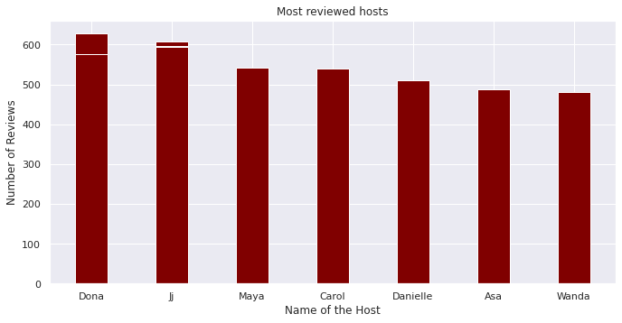
Exploratory Data Analysis
Relation between hosts and most user reviews
Observation:
Dona has got the Most user review but we can’t say he/she is the busiest person.

Slide 24
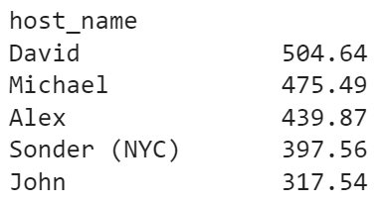
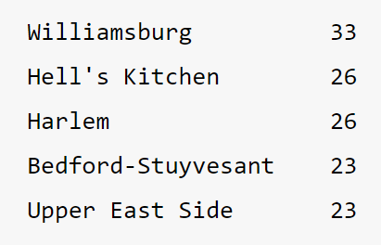
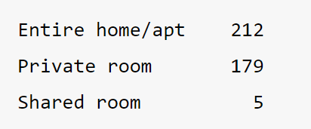
Exploratory Data Analysis
Find busiest hosts with user reviews per month and explore details
DAVID’s Top Properties
Neighbourhood no’s
DAVID’s Types of Properties
reviews per month
Types of room no’s
Observation:
1. David gets maximum 'reviews_per_month' equals 504.64. So we can assume he might be the busiest person.
2. David has a total of 396 properties.
3. He has a hosting room mostly in top neighborhoods.
4. He has hosted mostly entire home/apt types of room.

Slide 25
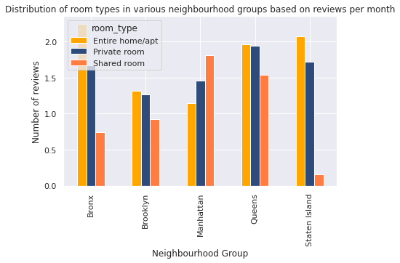
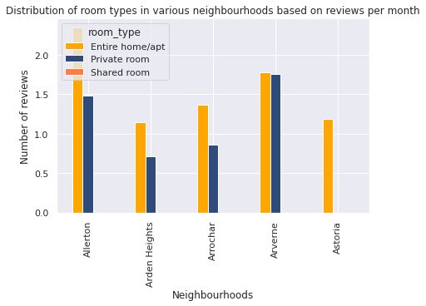
Exploratory Data Analysis
Noticeable Traffic difference across neighbourhood groups
Review per month
Review per month
Observation:
1. Except for Manhattan, in all the neighborhood groups, 'Entire home/apt' is the room type that gets the most traffic, although it is the most costlier type of property.
2. Overall if we see, Allerton, Bronx has the highest traffic. Thus, we can conclude that throughout New York city there is a great preference for Entire apt as compared to private or shared rooms.

Slide 26
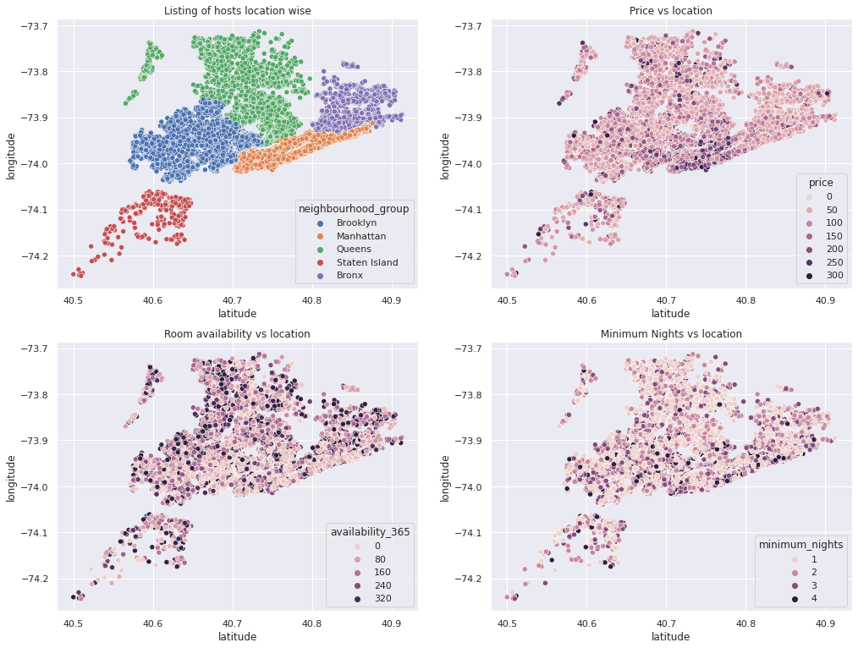
Exploratory Data Analysis
Explore the relations according to geometrical location
Observation:
1. In the first plot(location-wise): we got an impressive look at a Scatter-plot of a dense area of a neighborhood group.
2. In the second plot(price vs location): we have capped the price at $300 for better visualization and found, that Manhattan has mostly costly room listings.

Slide 27
Conclusion
This Airbnb dataset appeared to be a very rich dataset with a variety of columns that allowed us to do deep data exploration on each significant column presented. First, we have found hosts that take good advantage of the Airbnb platform and provide the most listings. After that, we proceeded with analyzing boroughs and neighborhood listing densities and which areas were more popular than others. Further, we came back to the first column with name strings and had to do a bit more coding to parse each title and analyze existing trends on how listings are named as well as what was the count for the most used words by hosts. Lastly, we found the most reviewed listings and analyzed some additional attributes.
Overall, We philosophied about the variables, we analyzed 'Price' along with the most correlated variables, and we also dealt with missing data and outliers. That's a lot of work that Python helped us make easier.

